Slide 1
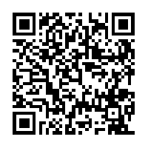
Rhetoric for All:
Teaching Rhetorical Analysis in the High School Classroom
http://tinyurl.com/rhetoricforall
Kimberly Gwizdala: kimberly_gwizdala@glenbard.org
Jennifer Shackleton: jshackleton@elmhurst205.org
Beth Fleming: efleming@elmhurst205.org
Jessica Noble: jnoble@elmhurst.org
Notes:
Gwiz leads the way!

Slide 2
Context: Establishing the Exigence
New SAT
Writing and Language (multiple choice)
Essay exam (rhetorical analysis)
District mandates encouraging students to take AP courses (EOS)
Common Core push to teach more nonfiction--many secondary English classes primarily teach fiction texts
Students need to become critical evaluators of the messages surrounding them daily
Today, students will need to have to evaluate language and structure to be successful. Where do you start!?
Notes:
Gwiz

Slide 3
Context: SAT Exam
Write an essay in which you explain how [the author] builds an argument to persuade [his/her] audience that [author’s claim].
In your essay, analyze how [the author] uses evidence, reasoning, or stylistic/persuasive elements to strengthen the logic and persuasiveness of [his/her] argument.
Be sure that your analysis focuses on the most relevant features of the passage. Your essay should not explain whether you agree with [the author’s] claims, but rather explain how the author builds an argument to persuade [his/her] audience.
http://collegereadiness.collegeboard.org/sat/inside-to-test/essay
Basically: How does the writer convey his or her message?
Notes:
Beth

Slide 4
Today, we will:
understand the purposes for teaching rhetoric.
review rhetorical terms.
offer a variety of activities that invite students of varying levels and interests to access rhetoric.
help you move your students up the rhetorical ladder.
Notes:
Jen

Slide 5
Why do we teach rhetorical analysis?
It is not just about writing; it is a READING skill.
Not about product as much as a thinking process.
We need to help students become critical evaluators of the world around them.
Notes:
Jess

Slide 6
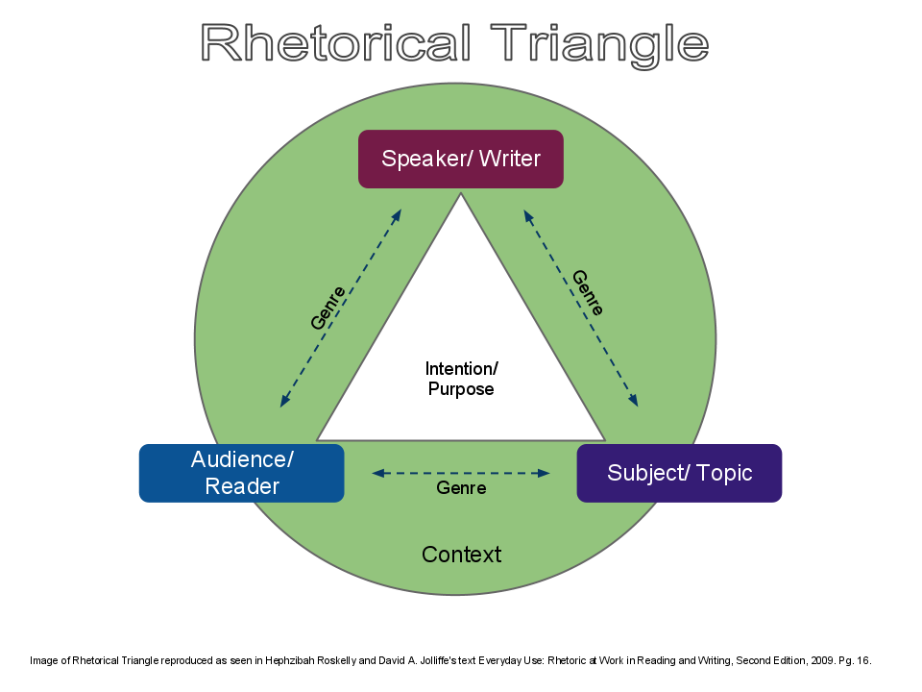
Defining the terms: How do we teach students to recognize
the what and the how?
Push students to move beyond message!
Exigence: a case or situation that demands prompt action or remedy.
Purpose/Goal: the author’s intended reason for writing. What he/she hopes to accomplish through this.
Speaker: The creator of the artifact.
Audience: The primary receiver of the information.
Approach: the overall strategy the author uses to deliver his/her message
Message: The intended argument or idea the author wants the audience to understand.
Notes:
Jess

Slide 7
The BIG 4: What to Ask When Dealing with Nonfiction
What is the context/situation of the piece?
Who is the intended audience?
What is the writer’s overall organizational approach?
What is the writer’s purpose and message?
Notes:
Gwiz

Slide 8
Letterman’s Top “ten (or seven)” Ways to Move Students Towards Rhetorical Analysis
Because text can be difficult, we ask the reading questions about visual texts first and then move towards written text. (Enter at the skill level of your students)
Real-life Scenarios
Bumper Stickers / Billboards
Static Images
Commercials/PSA/Film Clips
Graphic Novels
Speeches
Longer written text (nonfiction and fiction)
Notes:
Beth

Slide 9
Scenario Example 1
Mrs. Oakley is a no-nonsense teacher; she does not tolerate whining, excuses, or poor work. She believes the best way for students to improve as writers is to “Write, write, and write again.” She assigns an essay a week, come rain or shine, flood or plague. She assigned a five-page Romeo and Juliet paper due immediately following Winter Break. Her first period class wants to convince her to change the due date. How will they convince her?
Notes:
Jess

Slide 10
Scenario Example 2
Jason and Christa are best friends. They live in the same neighborhood and they have known each other since first grade. Jason is in love with Christa and he wants to ask her to the Prom, but he knows she will be surprised because they’ve always been “just friends.” How will he ensure that she says yes?
Notes:
Jess

Slide 11
Scenario Example 3
When interim grade reports came out Ellie knew she’d be in trouble. She was right; her parents’ reaction was swift and definitive: no TV, no phone, no computer except for homework, and no going out—school nights or weekends—until her grades came back up. She can live without the TV and the computer, and survive not going out, but the phone? No way. She has to convince her parents that taking away her phone is not necessary. How will she go about persuading them?
Notes:
Jess

Slide 12
Bumper Stickers Procedure
Walk around a parking lot (be careful!)
On side one of your organizer, write down as many bumper stickers as you can see and describe the different visual and textual elements you can see.
Write down the make and model of each car in the next column.
Back in the classroom...
Consider context: lot location? Type of car? Details about the car?
What message does this sticker convey?
How did the details influence your thinking about its meaning?
What can you infer about the driver of this car from this message?
Notes:
Jen

Slide 13
Examples of stickers
Notes:
Jen

Slide 14
Static Images Procedure
Summarize what you see.
Fondle the details (ala Nabokov)! About what do the elements in the piece make you think?
Walk through your SMEARS elements (specifics on next slide).
When you put them together, what overall message do they suggest?
CHALLENGE (If your kids are ready): What overall approach does the artist use?
Notes:
Gwiz

Slide 15
Static images
SMEARS:
S: Significant elements
M: What’s Missing?
E: What Emotion is conveyed?
A: What is the Argument?
R: Relationship. How do the different elements play off one another?
S: What is the Subject matter of this piece?
Aware Helpline in Singapore. 2008.
SMEARS: Courtesy of Emily Richardson, Communication Arts Teacher & Learning Support Coach NNHS
Notes:
Gwiz

Slide 16
SMEARS:
S: Significant elements
M: What’s Missing?
E: What Emotion is conveyed?
A: What is the Argument?
R: Relationship. How do the different elements play off one another?
S: What is the Subject matter of this piece?
Be Someone Else. Mint Vinetu.
Notes:
Gwiz

Slide 17
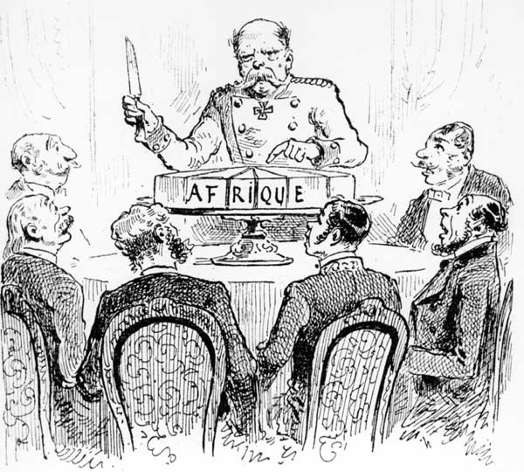
Using Political Cartoons
Notes:
Gwiz

Slide 18
Use With Book Covers/ Film Screenshots
The Crucible directed by Nicholas Hytner.
Notes:
Gwiz

Slide 19
Note: ABOUT Approach/chunking into sections
Moving from static images to dynamic ones can be tricky because students must
“read” many images separately, working to identify visual/textual choices within
consider how this progression of images/techniques work together to convey meaning
identify what overall approach is being used
THEN seek to identify a message
Notes:
Beth

Slide 20
Commercials/Psas Procedure
Watch the video clip you have been assigned.
Take notes on the 5 rhetorical questions we have been using to analyze text (Context, Audience, Approach, Message).
Separate the commercial into sections that have like ideas or purpose. (What does each intend to do?)
Put them together to develop an overall approach--the HOW
Answer the prompt: What is the message and how does the director present it?
If students struggle with “message,” talk about “purpose” as well.
Provide an outline for how you would prepare this analysis.
Lead a verbal presentation of the analysis OR use digital supports (Video Ant).
Notes:
Jess

Slide 21
Commercial/PSA Examples
Microsoft “Empowering” -https://www.youtube.com/watch?v=qaOvHKG0Tio
Save the Children- https://www.youtube.com/watch?v=RBQ-IoHfimQ
1 is 2 Many PSA- https://www.youtube.com/watch?v=xLdElcv5qqc
Levi’s “O Pioneers”--https://www.youtube.com/watch?v=HG8tqEUTlvs
Under Armour Giselle B. “I will what I want” https://www.youtube.com/watch?v=H-V7cOestUs
Subaru “From the Child’s Seat”--https://www.youtube.com/watch?v=hKkfQlhNxdI
Seatbelt--https://www.youtube.com/watch?v=h-8PBx7isoM
Nike “Dream Deferred” --https://www.youtube.com/watch?v=QrfLQpN2gZs
Notes:
Jess

Slide 22
Let’s Walk through the process together
https://www.youtube.com/watch?v=RBQ-IoHfimQ
Answer the BIG 4
Context
Audience
Approach
Message
Make a claim: How does the PSA convey its message?
Build the outline: How will you take us through the piece?
Notes:
Jen

Slide 24
Graphic Novel procedures: Persepolis
Reading: Below is a panel from Persepolis. Read and annotate it for distinct language and visual choices directly on this sheet. You should refer to page 52 to contextualize the panel, but your analysis should be about the panel below.
Writing: In a well-developed paragraph, articulate the idea Satrapi conveys and explain how the specific techniques you identify work together to create that meaning. In other words, WHAT does this panel mean and HOW is that meaning conveyed?
Notes:
Beth

Slide 25
Speeches and Letters: procedure
Annotate for the BIG 5
Separate sections and determine purposes to aid with overall approach
Create claim combining the message and approach
Create the support
Use the sections to guide subclaim creation
Select evidence
Analyze the evidence
identify specific techniques and relate them back to your subclaim. (REPEAT)
Notes:
Gwiz

Slide 26
Speeches examples
Jonathan Edwards’ “Sinners in the Hands of an Angry God”
AP Rhetorical Analysis Essay samples available on the College Board site
Thatcher’s Eulogy of Ronald Reagan, Benjamin Banneker’s Letter to Thomas Jefferson, Samuel Johnson’s Letter to a Mother, JFK on Steel Prices, etc.
Michelle Obama’s DNC speech and Ivanka Trump’s RNC speech
Mary Fisher’s 1992 “A Whisper of Aids”
President George W. Bush’s 9/11 Speech
Notes:
Gwiz

Slide 27
Rhetorical Analysis of longer Text looks just the same
Examples:
Creative non-fiction like Capote’s In Cold Blood
Memoirs like McCourt’s Angela’s Ashes or Jeannette Walls’s The Glass Castle
These skills easily crossover to any literary analysis you use in fiction
terminology just changes!
Notes:
Jen

Slide 28
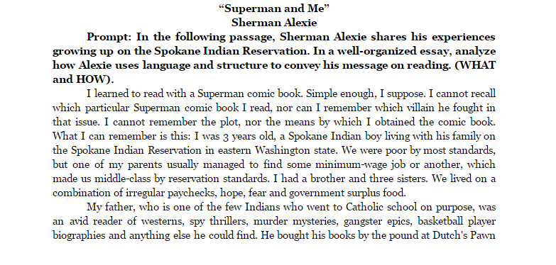
“Answer the prompt”
Notes:
Jess

Slide 29
Other Resources and Suggestions
Thomas Newkirk’s “How We Really Read Nonfiction”
Netflix’s Amanda Knox Promos: Comparative Analysis
“Suspect Her”
“Believe Her”
State Farm Commercials
Seek out rhetorical opportunities in the classroom:
Student interactions
School policies
Examples: Columbus Day protest @ Reavis High School, Colin Kaepernick and National Anthem,
Incorporate rhetorical analysis into research process
Questions?
Notes:
Gwiz

Slide 30
Rhetoric for All:
Teaching Rhetorical Analysis in the High School Classroom
http://tinyurl.com/rhetoricforall
Kimberly Gwizdala: kimberly_gwizdala@glenbard.org
Jennifer Shackleton: jshackleton@elmhurst205.org
Beth Fleming: efleming@elmhurst205.org
Jessica Noble: jnoble@elmhurst.org
Notes:
Gwiz leads the way!

